Slide 1

6th Grade Math
Unit 7, Lesson 12 Dividing Integers Using Integer Chips Volume 2, pg. 55

Slide 2


Benchmark
MA.6.NSO.4.2
Apply and extend previous understandings of operations with whole numbers to multiply and divide integers with procedural fluency.
volume 2, pg. 55

Slide 3
Integrated Mathematical Thinking and Reasoning Standard
MA.K12.MTR.5.1 Use patterns and structure to help understand and connect mathematical concepts.
volume 2, pg. 55

Slide 4

Learning Target
I can use integer chips and patterns to discover rules for dividing integers.
volume 2, pg. 55

Slide 5

Warm-Up
volume 2, pg. 55

Slide 6
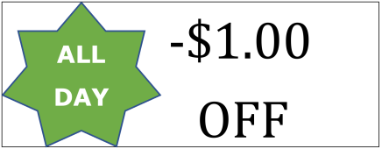
7.12.1 Warm-Up: Notice and Wonder
Write down one thing you notice about the picture.
Write down one thing you wonder about the picture.
Isaac described the image as a math fail. Why do you think he described it that way?
volume 2, pg. 55

Slide 7

Guided Instruction
volume 2, pg. 56

Slide 8

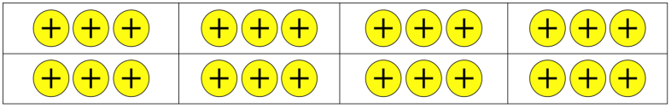
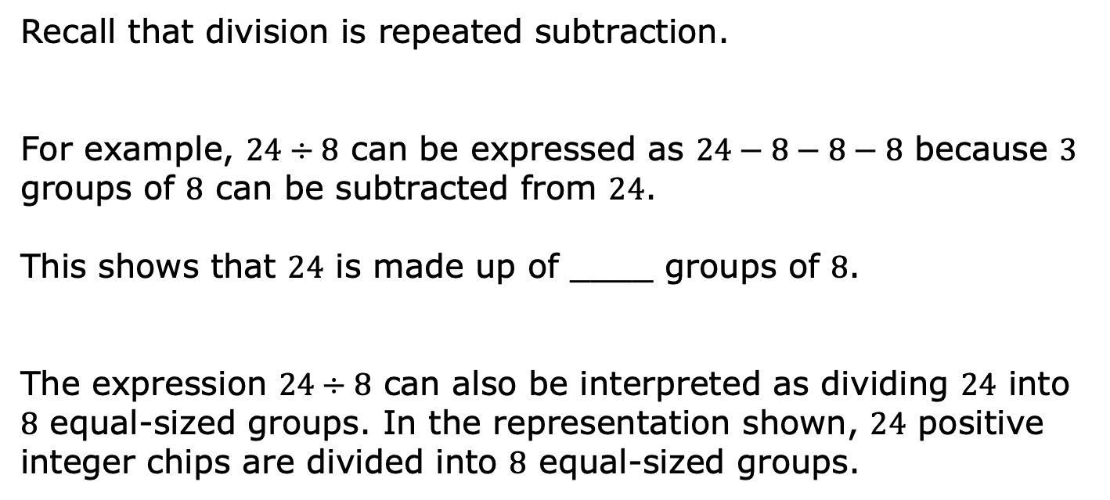
7.12.2 Guided Instruction: Using Integer Chips to Represent Division
Recall that division is repeated subtraction.
For example, $24÷8$ can be expressed as $24−8−8−8$ because $3$ groups of $8$ can be subtracted from $24$.
This shows that $24$ is made up of ____ groups of $8$.
The expression $24÷8$ can also be interpreted as dividing $24$ into $8$ equal-sized groups. In the representation shown, $24$ positive integer chips are divided into $8$ equal-sized groups.
volume 2, pg. 56

Slide 9
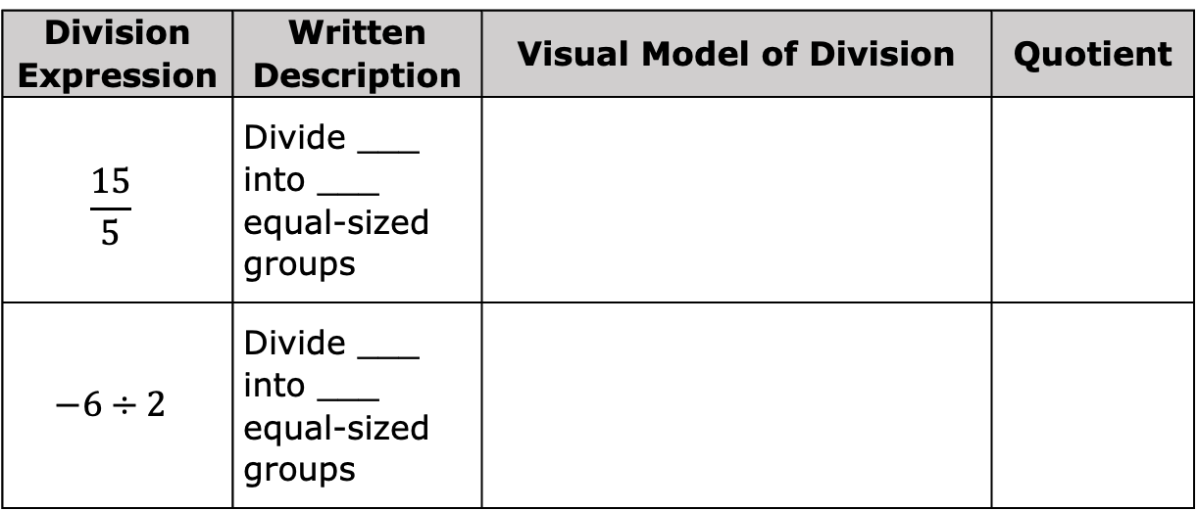
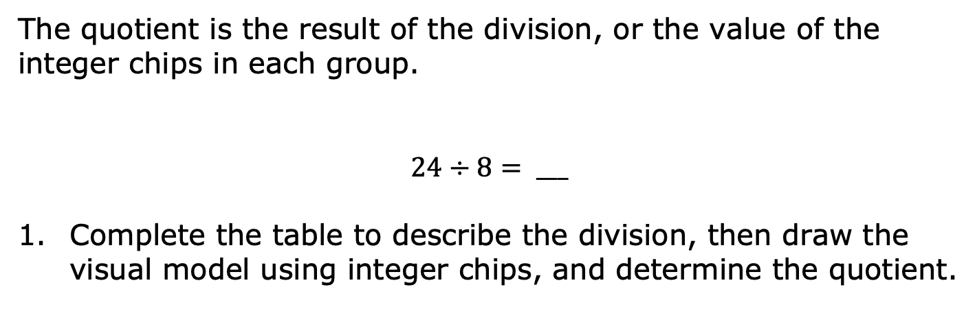
The quotient is the result of the division, or the value of the integer chips in each group.
$$24÷8= ___$$
Complete the table to describe the division, then draw the visual model using integer chips, and determine the quotient.
Division Expression | Written Description | Visual Model of Division | Quotient
$$\frac{15}{5}$$ | Divide ___ into ___ equal-sized groups
$$−6÷2$$ | Divide ___ into ___ equal-sized groups
volume 2, pg. 56

Slide 10
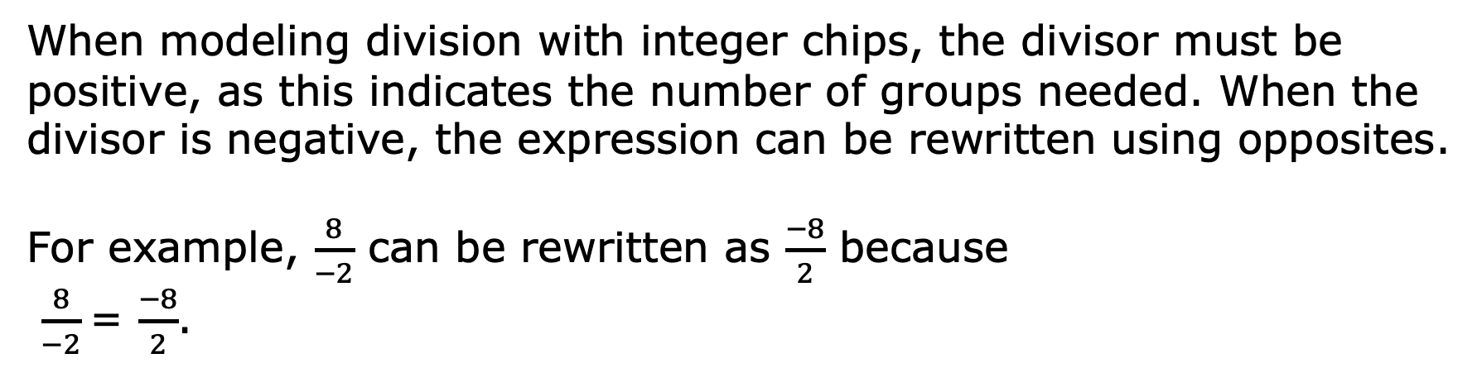
When modeling division with integer chips, the divisor must be positive, as this indicates the number of groups needed. When the divisor is negative, the expression can be rewritten using opposites.
For example, $\frac{8}{−2}$ can be rewritten as $\frac{−8}{2}$ because
$\frac{8}{−2}$= $\frac{−8}{2}$.
volume 2, pg. 56

Slide 11
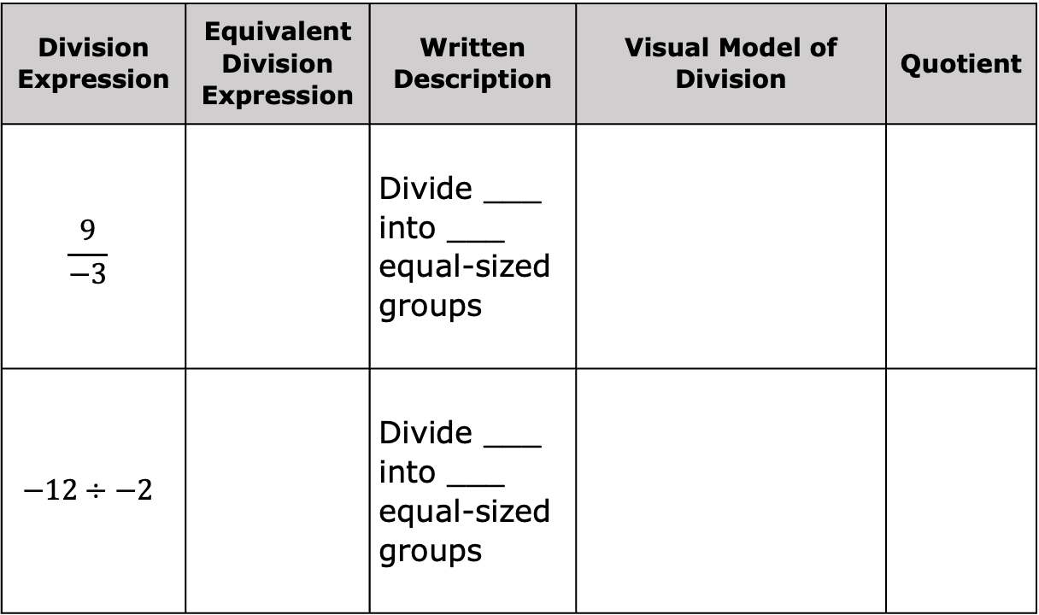
Division Expression | Equivalent Division Expression | Written Description | Visual Model of Division | Quotient
$$\frac{9}{−3}$$ |  | Divide ___ into ___ equal-sized groups
$$−12÷−2$$ |  | Divide ___ into ___ equal-sized groups
volume 2, pg. 57

Slide 12
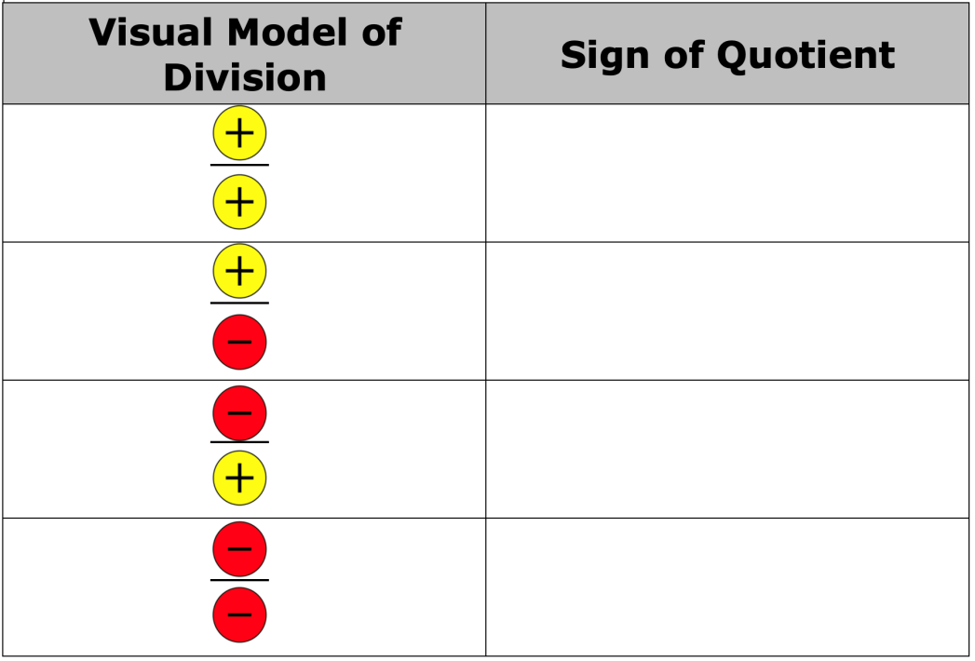
Use the pattern of the division in the tables to complete the rules by drawing the sign of the quotient as an integer chip.
volume 2, pg. 57

Slide 13

Collaboration
volume 2, pg. 57

Slide 14

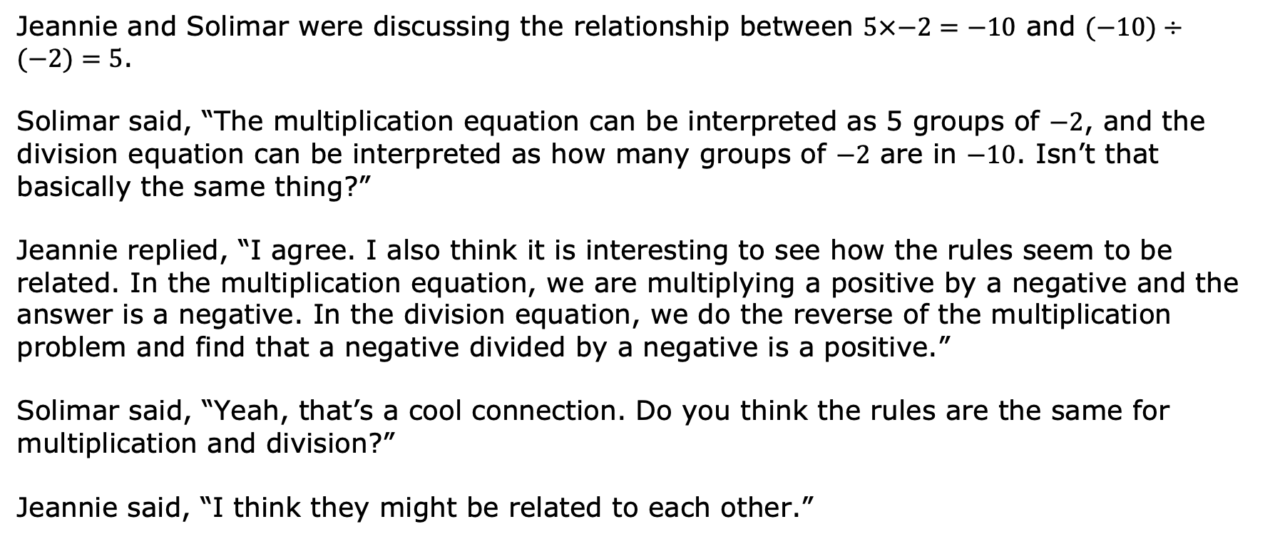
7.12.3 Collaboration: How Are Integer Multiplication and Division Related?
Jeannie and Solimar were discussing the relationship between $5×−2=−10$ and $(−10)÷(−2)=5$.
Solimar said, “The multiplication equation can be interpreted as 5 groups of $−2$, and the division equation can be interpreted as how many groups of $−2$ are in $−10$. Isn’t that basically the same thing?”
Jeannie replied, “I agree. I also think it is interesting to see how the rules seem to be related. In the multiplication equation, we are multiplying a positive by a negative and the answer is a negative. In the division equation, we do the reverse of the multiplication problem and find that a negative divided by a negative is a positive.”
Solimar said, “Yeah, that’s a cool connection. Do you think the rules are the same for multiplication and division?”
Jeannie said, “I think they might be related to each other.”
volume 2, pg. 57

Slide 15
Discuss Solimar and Jeannie’s conversation with your partner.
Create two integer division equations that can be rewritten with the related multiplication equation.
Division Equation | Related Multiplication Equation
volume 2, pg. 57

Slide 16

Bring It Together
volume 2, pg. 58

Slide 17

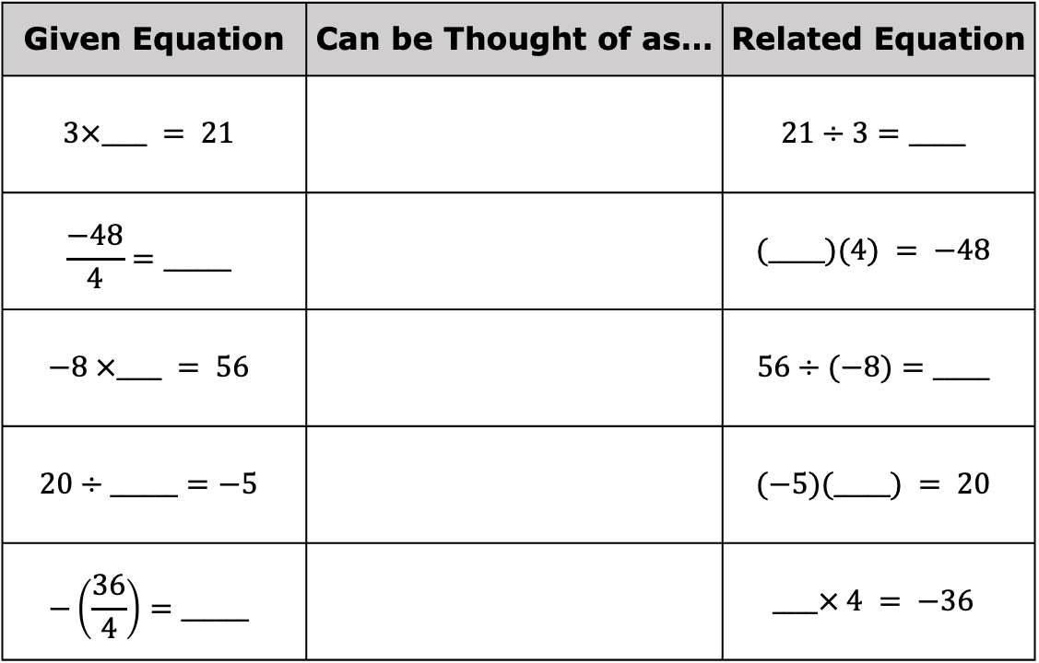
7.12.4 Bring It Together: How Are Integer Multiplication and Division Related?
Write the missing factor in each given equation. Then, write the related division or multiplication equation.
Given Equation | Can be Thought of as… | Related Equation
$$3×____ = 21$$ |  | $$21÷3=_____$$
$$\frac{−48}{4}=______$$ |  | $$(_____)(4) = −48$$
$$−8 ×____ = 56$$ |  | $$56÷(−8)=_____$$
$$20÷______=−5$$ |  | $$(−5)(_____) = 20$$
$$−\left(\frac{36}{4}\right)=______$$ |  | $$____× 4 = −36$$
volume 2, pg. 58

Slide 18
How are rules for multiplication of integers related to the rules for division of integers?
volume 2, pg. 58

Slide 19
Collaboration
volume 2, pg. 58

Slide 20
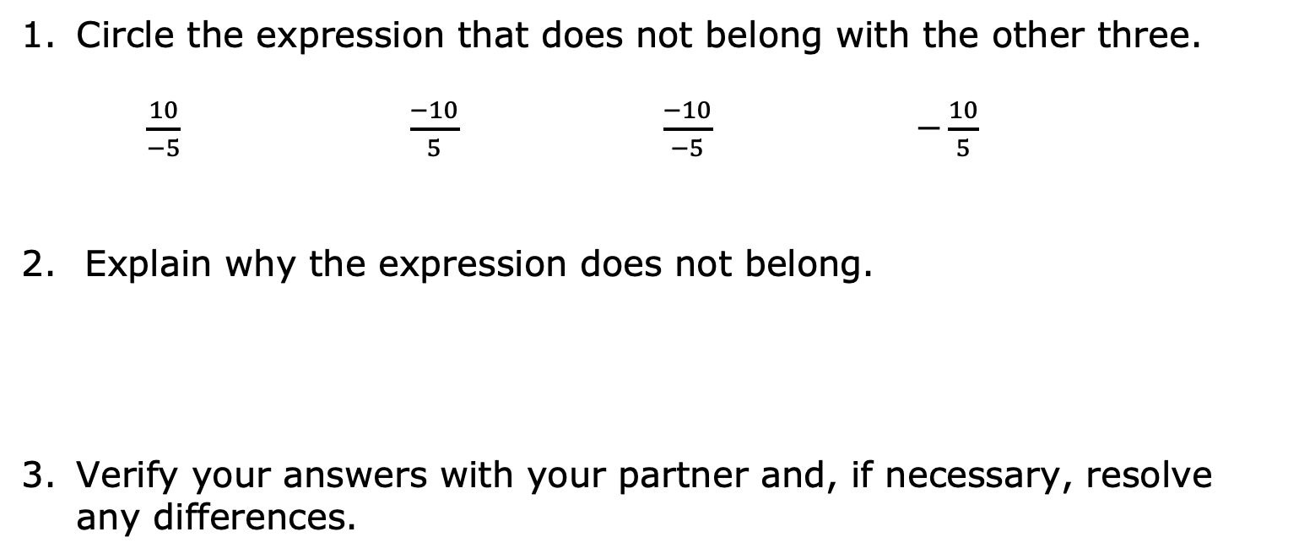
7.12.5 Collaboration: Which One Doesn’t Belong?
Circle the expression that does not belong with the other three.
$\frac{10}{−5}$ $\frac{−10}{5}$ $\frac{−10}{−5}$ $−\frac{10}{5}$
Explain why the expression does not belong.
Verify your answers with your partner and, if necessary, resolve any differences.
volume 2, pg. 58

Slide 21
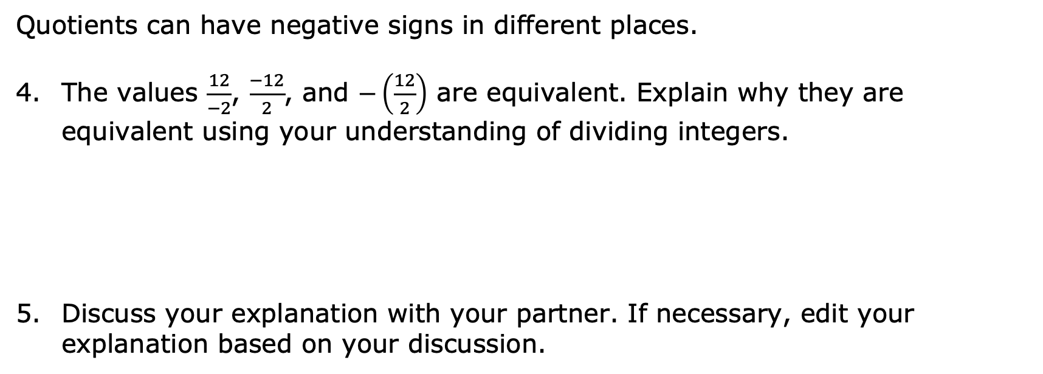
Quotients can have negative signs in different places.
The values $\frac{12}{−2}$, $\frac{−12}{2}$, and $−\left(\frac{12}{2}\right)$ are equivalent. Explain why they are equivalent using your understanding of dividing integers.
Discuss your explanation with your partner. If necessary, edit your explanation based on your discussion.
volume 2, pg. 58

Slide 22
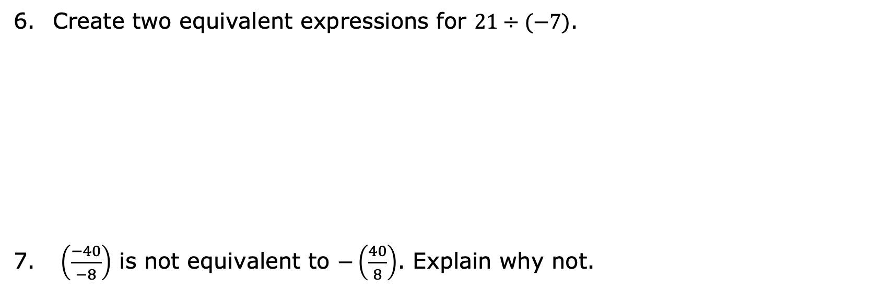
Create two equivalent expressions for $21÷(−7)$.
$\left(\frac{−40}{−8}\right)$ is not equivalent to $−\left(\frac{40}{8}\right)$. Explain why not.
volume 2, pg. 58

Slide 23

Guided Practice
volume 2, pg. 59

Slide 24


7.12.6 Guided Practice: Dividing Integers
Find each quotient.
$12÷−4= ____$ b. $\frac{−63}{−9}= ____$
c. $−\left(\frac{28}{4}\right)= ____$ d. $60÷5= ____$
e. $−\left(\frac{−30}{−5}\right)= ____$
volume 2, pg. 59

Slide 25

Create two expressions equivalent to $\frac{−20}{10}$.
What is the value of the expressions above?
volume 2, pg. 59

Slide 26

Your Turn
volume 2, pg. 59

Slide 27

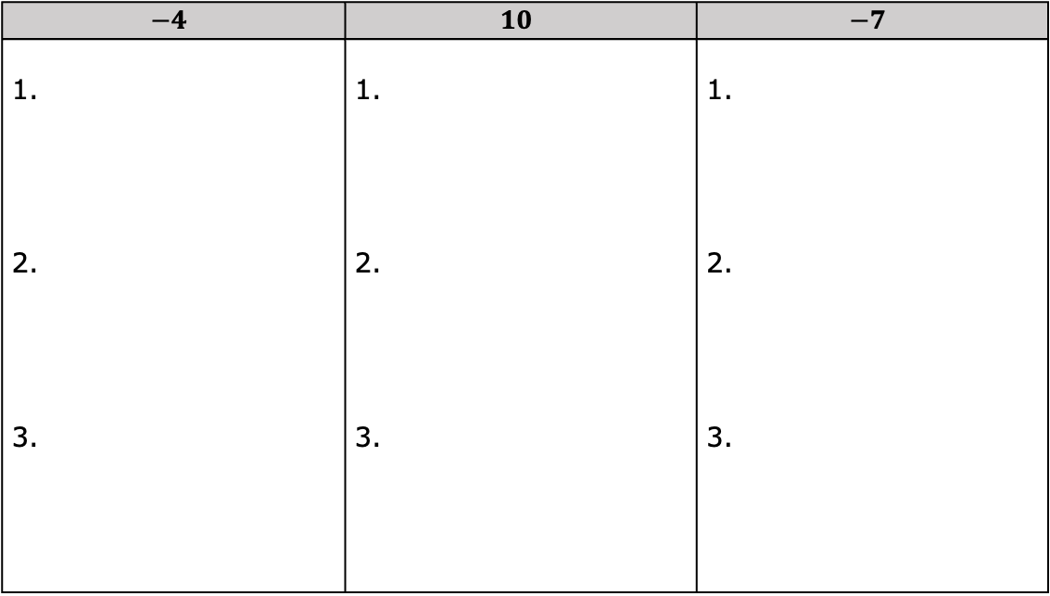
7.12.7 Your Turn!
In each column below, create three different division expressions that would result in the given quotient.
$$−4$$ | $$10$$ | $$−7$$
1. 2. 3. | 1. 2. 3. | 1. 2. 3.
volume 2, pg. 59

Slide 28

Wrap-Up
volume 2, pg. 60

Slide 29

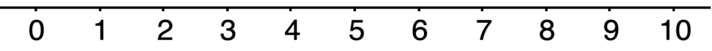
7.12.8 Wrap-Up: Reflection
Use the emoji scale to indicate your level of confidence with understanding and using the rules for multiplying and dividing integers.
volume 2, pg. 60

